Slide 1
The transcriptomic response of neuroblastoma cells to hypoxia
Authors:
Xheni Meci, Holger Scholz, Simon Kelterborn
Katharina , Karin Kirschner, Helena Landstorfer

Slide 2
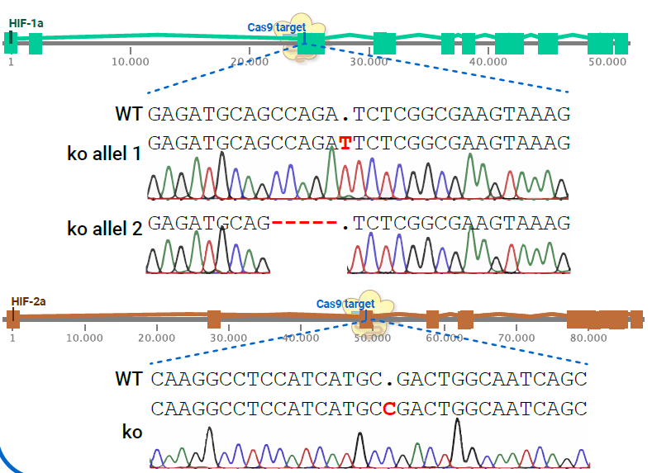
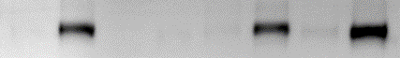
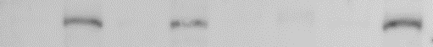
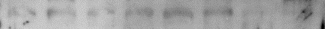

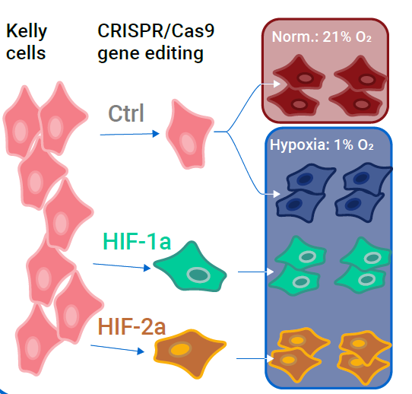
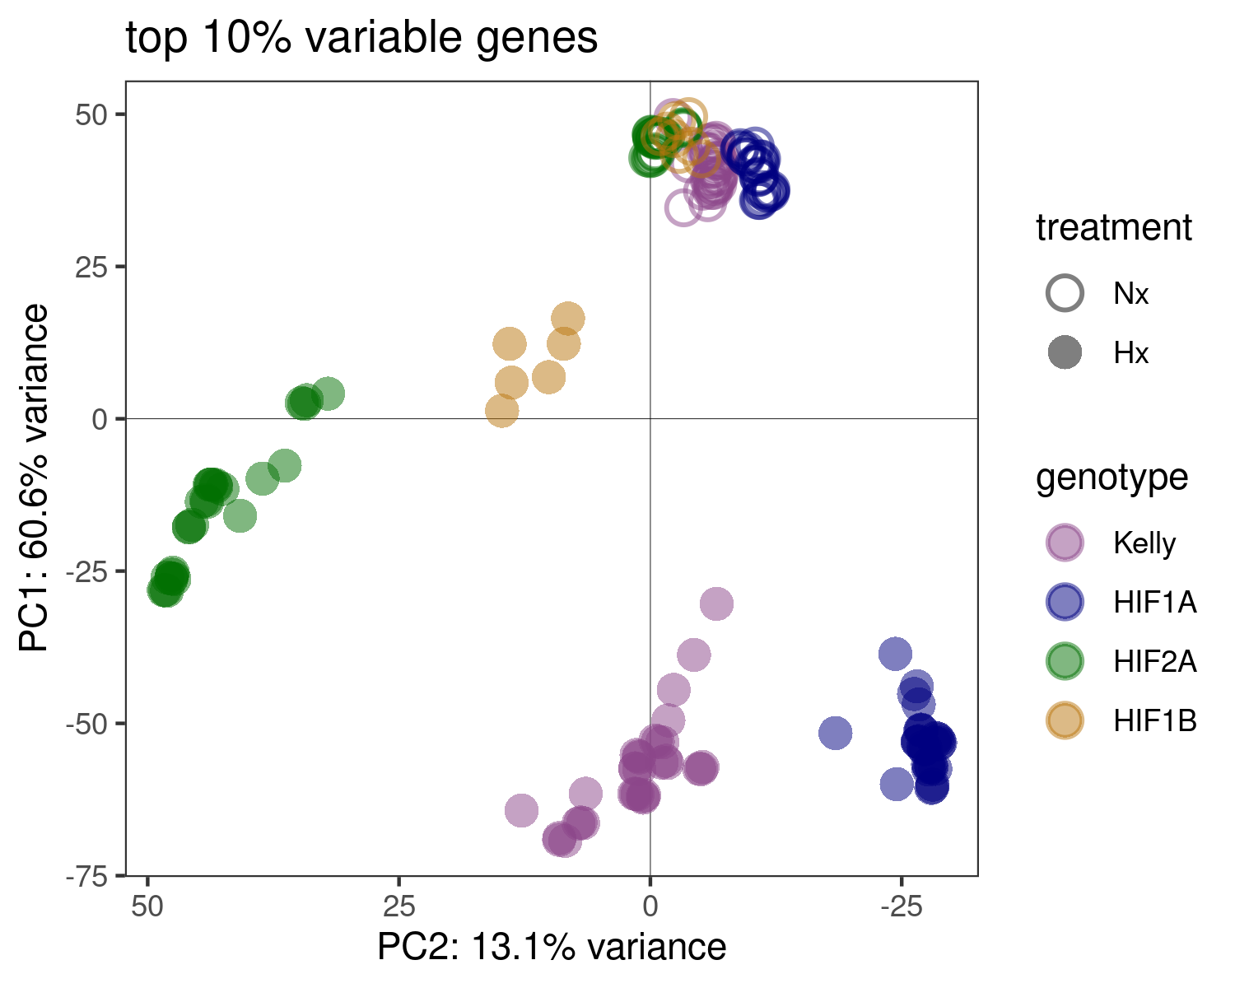
Fig. 1
Generation of HIF-KOs
A
B
empty vector
delHIF-1α
delHIF-2α
delHIF-1β/ARNT
Nx Hx
Nx Hx
Nx Hx
Nx Hx
HIF-1α
HIF-2α
HIF-1β/ARNT
ACTIN
+ Hif1b-KO
RNA-Seq experiment
C
D
+ Hif1b
Notes:
To Do:
Sequencing für Hif1b
Hif1b KO western
General:
Naming of mutants
HIF-1α-ko, delHIF-1α, ΔHIF-2α
Colours
A)
- add Hif1b gene knock-out;
HIF2a sequencing of second allel?
B)
Faint band in Hif-1b
C)
include sheme?
add Hif1b
D)
Colours?

Slide 3
Fig. 1
Figure 1. Overview of the experimental design and generation and characterization of HIF-knockout (KO) Kelly cells.
(A) Schematic representation of the CRISPR/Cas9-mediated knockout of HIF-1α,HIF-2α and HIF-1β in Kelly cells. Sequencing chromatograms confirm the small insertions or deletions resulting in frame shifts in the coding seqeunce in the respective genes.
(B) Immunoblot analysis of HIF-1α, HIF-2α, and HIF-1β protein expression in Kelly cells treated with empty vector and HIF-ko Kelly celllines.
(C) Schematic illustration of the RNA-Seq experiment. Control, HIF-1α, HIF-2α and HIF-1β knockout Kelly cells (delHIF-1α, delHIF-2α and delHIF-1β) were were exposed to normoxia (21% O₂) and hypoxic (0.5% O₂) conditions and subjected to RNA sequencing. The experiment was repeated 4 times and each repetition was carried out in triplicates.
(D) Principal component analysis (PCA) plot based on the top 10% most variable genes across all samples. Each dot represents a sample, colored according to the treatment (normoxia or hypoxia) and genotype (WT or HIF-ko).
Interpretation:
Samples align well over replicates
Normoxic samples cluster together across all genotypes
Under hypoxia genotypes seperate in different cluster, distinct hypoxia response in each HIF-ko
HIF1b-ko hypoxic samples show highest similarity to normoxia samples (lowest hypoxic response across all genotypes)

Slide 4
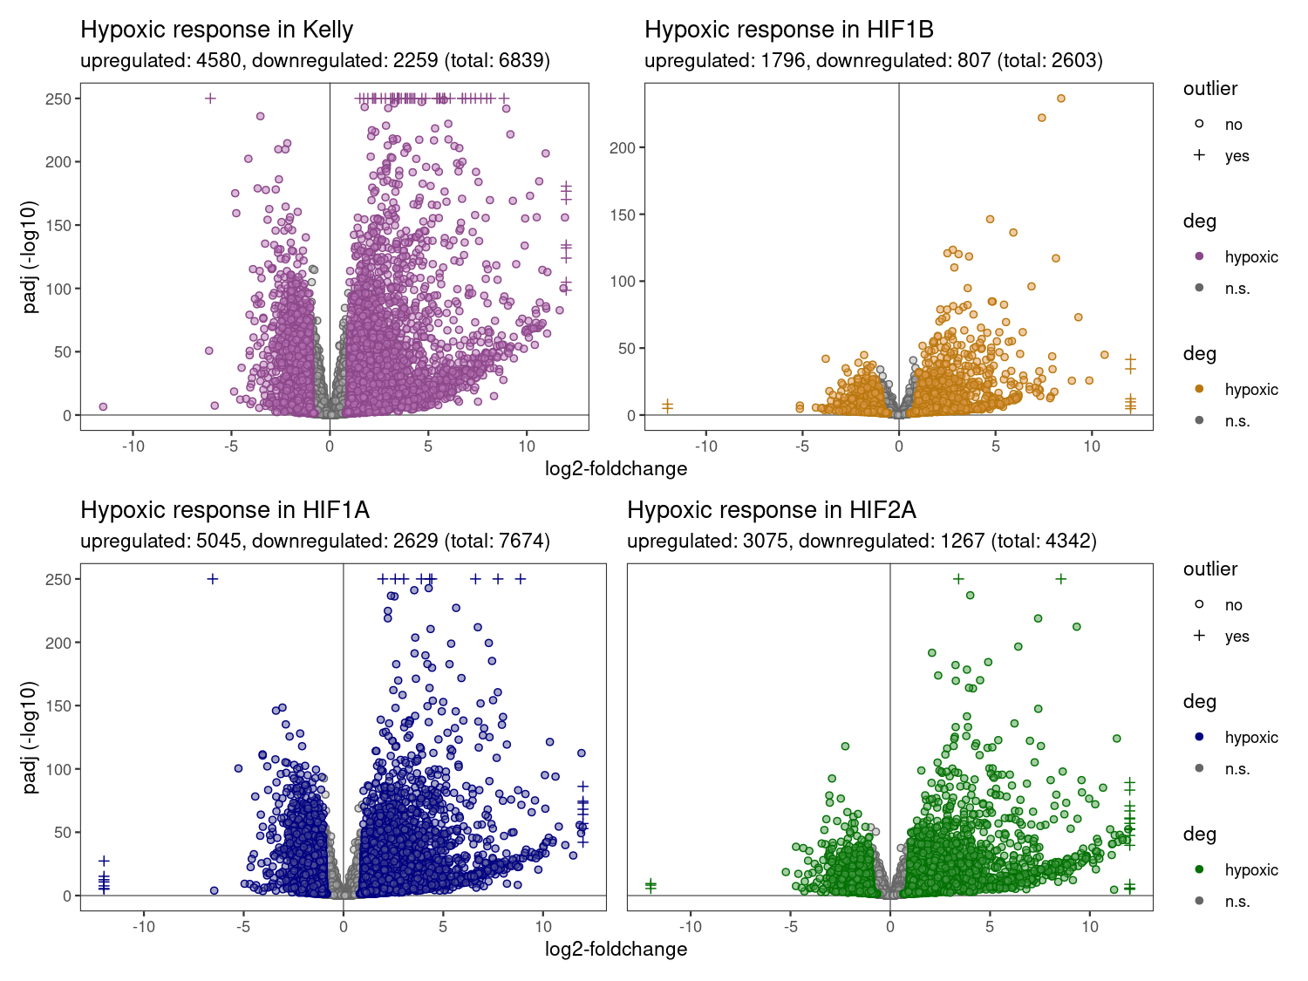
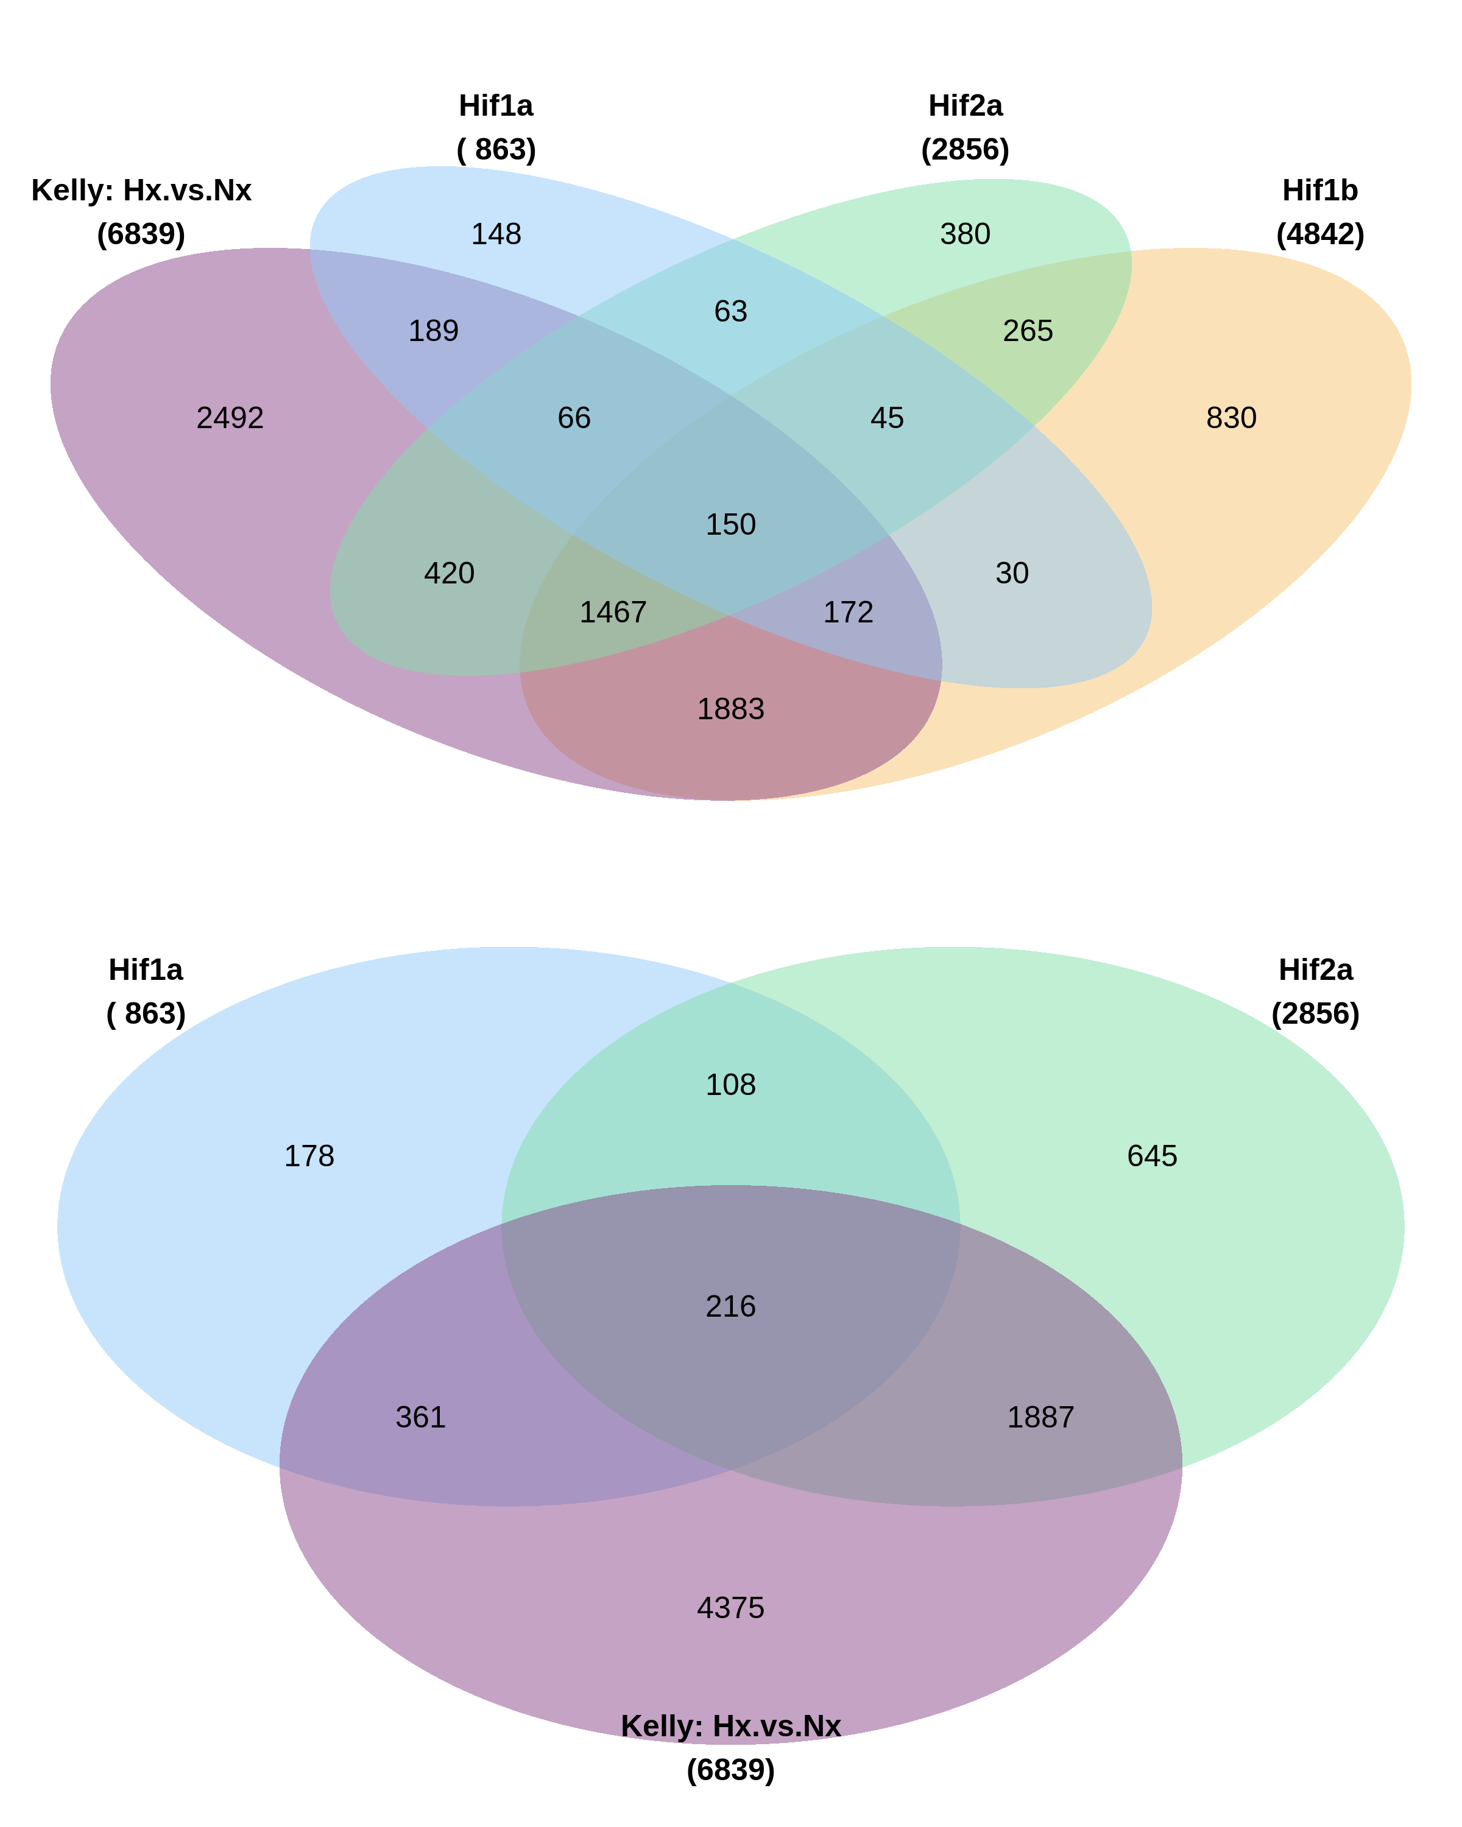
Fig. 2 v1
Hypoxic response (Simple)
Overlap of genes with differential effect vs. Kelly
(genes with different hypoxic effect than Kelly)
A
B
Cutoff: padj < 0.05,
log2-FC > 1,
baseMean > 0
-> Plotted are the points of the hypoxic response in each cellline (Hif1a: Hx vs. Nx)
-> Colored are the genes with significant changes
Notes:
A)
3 categorys: ns, significant, different from Kelly
OR 8 panels, difference hypoxia, difference genotypes
B)
4,3,2 groups? Suggest 2 groups: Hif1a & Hif2a

Slide 5
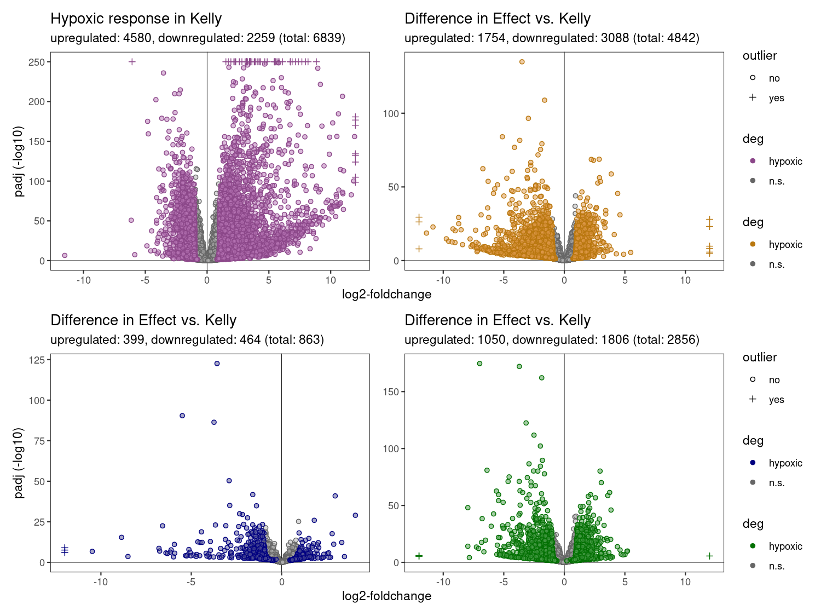
Genes with different hypoxic response in ko celllines compared to hypoxic response in Kelly cells
(i.e. HIF1A_Hx-Nx vs. Kelly_Hx-Nx)
Hypoxic response in ko celllines
(i.e. HIF1A_Hx vs. HIF1A_Nx)

Slide 6
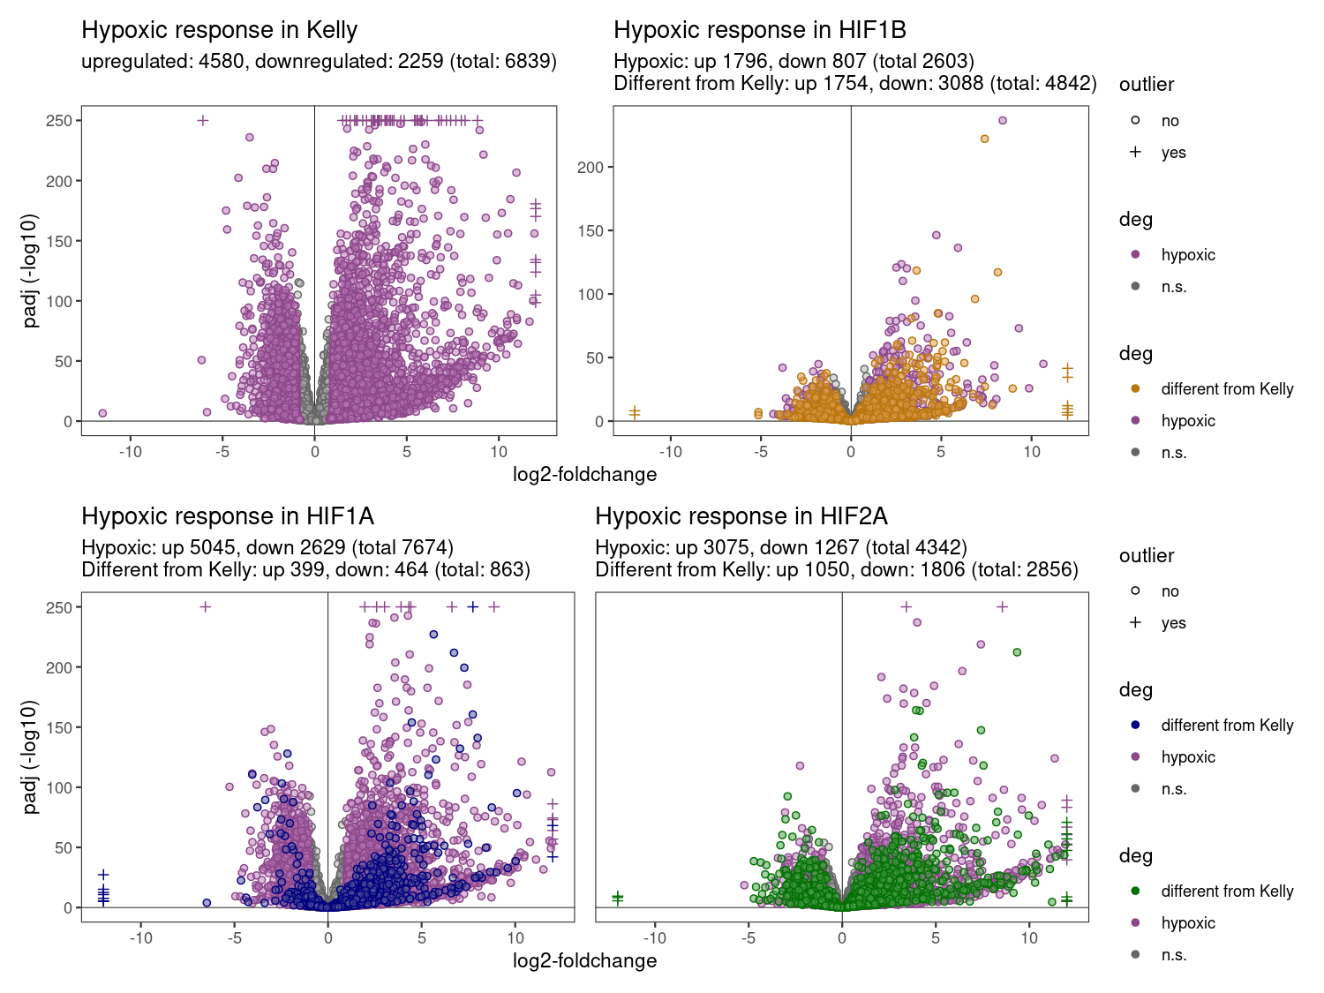
Fig. 2 v2
Hypoxic response and differential effect compared to Kelly (2 in 1)
Overlap of genes with differential effect vs. Kelly
(genes with different hypoxic effect than Kelly)
A
B
Cutoff: padj < 0.05,
log2-FC > 1,
baseMean > 0
-> Plotted are the points of the hypoxic response in each cellline (Hif1a: Hx vs. Nx)
-> Purple: Significant hypoxic genes
-> Yellow/Blue/Green: Genes with different hypoxic effect vs. Kelly
Notes:
A)
3 categorys: ns, significant, different from Kelly
OR 8 panels, difference hypoxia, difference genotypes
B)
4,3,2 groups? Suggest 2 groups: Hif1a & Hif2a

Slide 8
Fig. 2
Figure 2. Hypoxia induced genes.
A) Volcano plots illustrating differentially expressed genes (DEGs) in control Kelly cells (purple) and HIF-1α (blue), HIF-2α (green) and HIF-1β (yellow) knockout cells under hypoxic (0.5% O₂) compared to normoxic (21% O₂) conditions. Blue dots represent significantly differential expressed genes (p_{adjusted} < 0.05, log2foldchange > 1 or log2foldchange < -1). Coloured dots in mutant cell lines (purple, green, yellow) represent genes with a significantly different hypoxic effectcompared to Control Kelly cells.
B) Overlap of differentially expressed genes between HIF1a and HIF2a (+ Hif1B and all hypoxic genes in control Kelly cells)
Interpretation:
In all three HIF-ko, less genes are differentially expressed under hypoxia
HIF1a-ko shows least ko effect, most similiar to Kelly (863 genes differ from Kelly hypoxia effect)
HIF2a-ko shows stronger differences, 2856 genes are differentially expressed under hypoxia compared to Kelly
HIF1a-ko and HIF2a-ko show only some overlap (324 genes are differently expressed in both HIF-1a-ko and HIF-2a-ko)

Slide 9
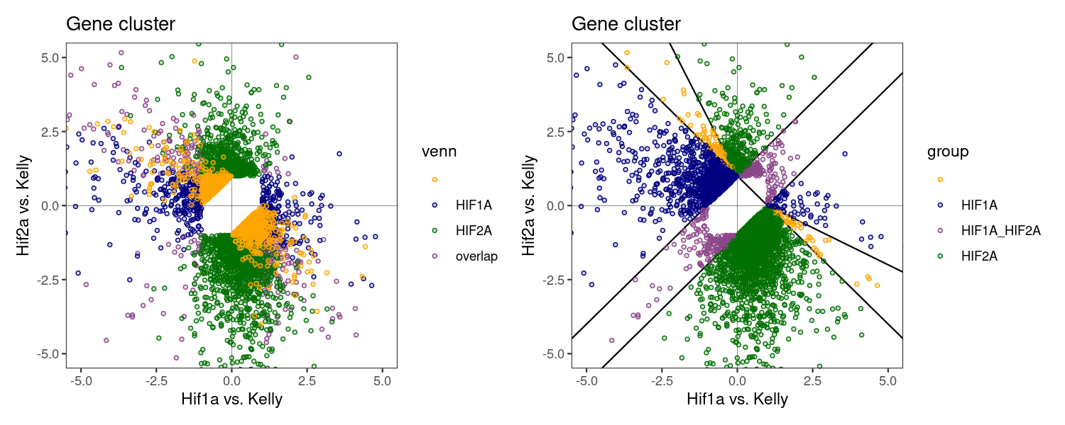
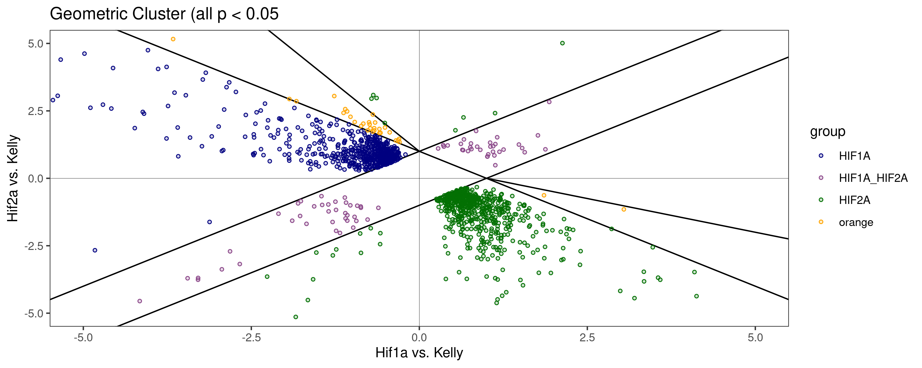
Fig. 3
Hif1a / Hif2a clustering
HIF1A: 1736
HIF2A: 3133
HIF1A_HIF2A: 334
„orange“: 171
-> Only few „parallel“: 334
-> Assign corners to HIF1A/HIF2A?
Notes:
Example counts plot!

Slide 10
Figure 3. Grouping genes in HIF-1a and HIF-2a responsive genes
A) Dot plot shows the effect (log2foldchange) of the knockout when comparing the hypoxic effect in the mutant cell line with the control Kelly cells. A positive value indicates a change in expression in the same direction as the Kelly control (Gene A is upregulated under hypoxia in Kelly cells and more upregulated in the mutant cell line) whereas a negative value results from opposite expression patterns (Gene B is upregulated under hypoxia in Kelly cells but less upregulated or downregulated in the mutant cell line). The disruption of HIF-1a leads to a higher hypoxic response of HIF2a genes and vice versa. In order to compensate for this overshoot, negative effects were given higher significance than positive effects.
Interpretation:
only very few genes that show same disrupted hypoxic response in HIF1A-ko and HIF2A-ko (purple).
Twice as many HIF2a (3133) genes than HIF1A (1736)

Slide 11
HIF1A
ENSEMBL | symbol | baseMean | Kelly.Hx.Nx.L2FC | Hif1a.Hx.Nx.L2FC | Hif2a.Hx.vs.Nx.log2FoldChange | Hif1a.Kelly.L2FC | Hif2a.Kelly.L2FC | Hif1b.KellyL2FC | Hif2a.Hif1a.L2FC
ENSG00000114023 | FAM162A | 12808 | 2,7 | -1,1 | 4,2 | -3,8 | 1,5 | 0,4 | 5,2
ENSG00000123095 | BHLHE41 | 591 | 4,8 | 1,0 | 7,4 | -3,7 | 2,7 | -1,9 | 6,4
ENSG00000176171 | BNIP3 | 21435 | 3,2 | -0,4 | 4,0 | -3,6 | 0,8 | -0,1 | 4,4
ENSG00000100314 | CABP7 | 2092 | 8,2 | 5,0 | 9,4 | -3,2 | 1,2 | -1,2 | 4,4
ENSG00000159208 | CIART | 2104 | 2,8 | -0,1 | 3,9 | -2,9 | 1,0 | -0,1 | 3,9
ENSG00000074800 | ENO1 | 193556 | 1,3 | -1,6 | 2,3 | -2,9 | 1,0 | 1,0 | 4,0
ENSG00000139832 | RAB20 | 773 | 2,7 | 0,2 | 3,6 | -2,5 | 0,9 | -0,6 | 3,4
ENSG00000079739 | PGM1 | 6603 | 1,3 | -1,2 | 2,2 | -2,5 | 0,9 | 0,4 | 3,4
ENSG00000146094 | DOK3 | 853 | 2,0 | -0,3 | 2,9 | -2,3 | 0,9 | -1,2 | 3,2
ENSG00000102144 | PGK1 | 69853 | 2,4 | 0,1 | 3,0 | -2,2 | 0,6 | 0,2 | 2,9
ENSG00000165802 | NSMF | 12663 | 0,9 | -1,3 | 2,4 | -2,2 | 1,5 | -0,4 | 3,7
ENSG00000118194 | TNNT2 | 957 | 2,1 | 0,0 | 4,3 | -2,1 | 2,2 | -0,7 | 4,3
ENSG00000291995 | GOLGA8A | 11149 | 2,5 | 0,4 | 3,6 | -2,1 | 1,1 | -0,4 | 3,2
ENSG00000291946 | NPW | 893 | 1,9 | -0,1 | 4,1 | -2,1 | 2,2 | 0,5 | 4,2
ENSG00000114480 | GBE1 | 3845 | 2,9 | 0,9 | 3,8 | -2,0 | 0,9 | -1,3 | 2,9
ENSG00000173157 | ADAMTS20 | 1183 | 2,5 | 0,6 | 3,4 | -1,9 | 0,9 | -1,1 | 2,8

Slide 12
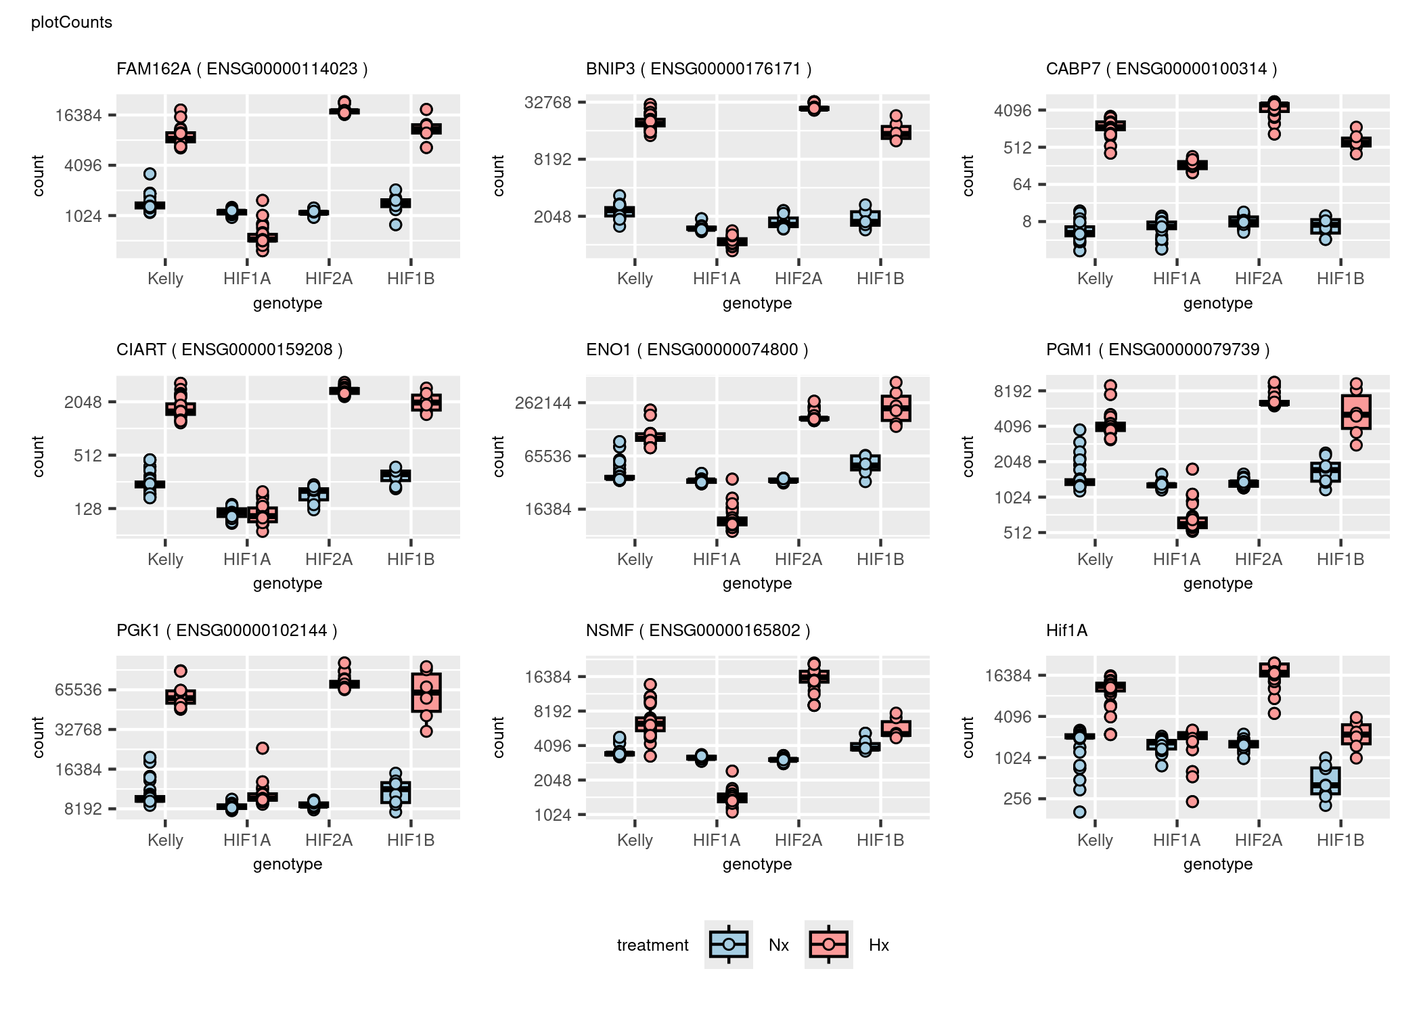

Slide 13
HIF2A
ENSEMBL | symbol | baseMean | Kelly.Hx.Nx.L2FC | Hif1a.Hx.Nx.L2FC | Hif2a.Hx.vs.Nx.log2FoldChange | Hif1a.Kelly.L2FC | Hif2a.Kelly.L2FC | Hif1b.KellyL2FC | Hif2a.Hif1a.L2FC
ENSG00000152822 | GRM1 | 542 | 6,7 | 7,8 | 1,0 | 1,0 | -5,7 | -6,4 | -6,7
ENSG00000183691 | NOG | 1681 | 12,1 | 10,2 | 6,9 | -1,8 | -5,1 | -9,1 | -3,3
ENSG00000189120 | SP6 | 1447 | 5,9 | 7,1 | 1,3 | 1,2 | -4,6 | -1,1 | -5,8
ENSG00000129757 | CDKN1C | 1909 | 8,0 | 6,3 | 3,4 | -1,7 | -4,5 | -5,2 | -2,9
ENSG00000148053 | NTRK2 | 692 | 6,8 | 8,0 | 2,5 | 1,3 | -4,2 | -6,8 | -5,5
ENSG00000116147 | TNR | 1919 | 2,3 | 3,5 | -1,4 | 1,2 | -3,8 | -3,6 | -4,9
ENSG00000106100 | NOD1 | 3289 | 3,5 | 3,9 | -0,2 | 0,4 | -3,7 | -3,5 | -4,1
ENSG00000120549 | KIAA1217 | 541 | 1,6 | 2,3 | -2,1 | 0,7 | -3,7 | -3,2 | -4,4
ENSG00000173762 | CD7 | 1205 | 3,4 | 4,5 | -0,3 | 1,1 | -3,7 | -2,4 | -4,8
ENSG00000096696 | DSP | 525 | 10,6 | 14,0 | 7,2 | 3,3 | -3,5 | -10,7 | -6,8
ENSG00000063015 | SEZ6 | 4952 | -1,7 | -2,4 | 1,4 | -0,7 | 3,1 | 1,8 | 3,8
ENSG00000197748 | CFAP43 | 1895 | 8,0 | 8,9 | 5,0 | 0,9 | -3,0 | -5,1 | -3,9
ENSG00000008853 | RHOBTB2 | 25463 | 3,8 | 4,4 | 0,9 | 0,6 | -2,9 | -2,4 | -3,6
ENSG00000285438 | SOX7 | 1112 | 3,5 | 4,4 | 0,6 | 0,9 | -2,9 | -3,1 | -3,8
ENSG00000081189 | MEF2C | 3673 | 2,6 | 3,1 | -0,2 | 0,4 | -2,8 | -2,4 | -3,2
ENSG00000122574 | WIPF3 | 649 | 6,0 | 5,2 | 3,3 | -0,9 | -2,8 | -3,2 | -1,9

Slide 14
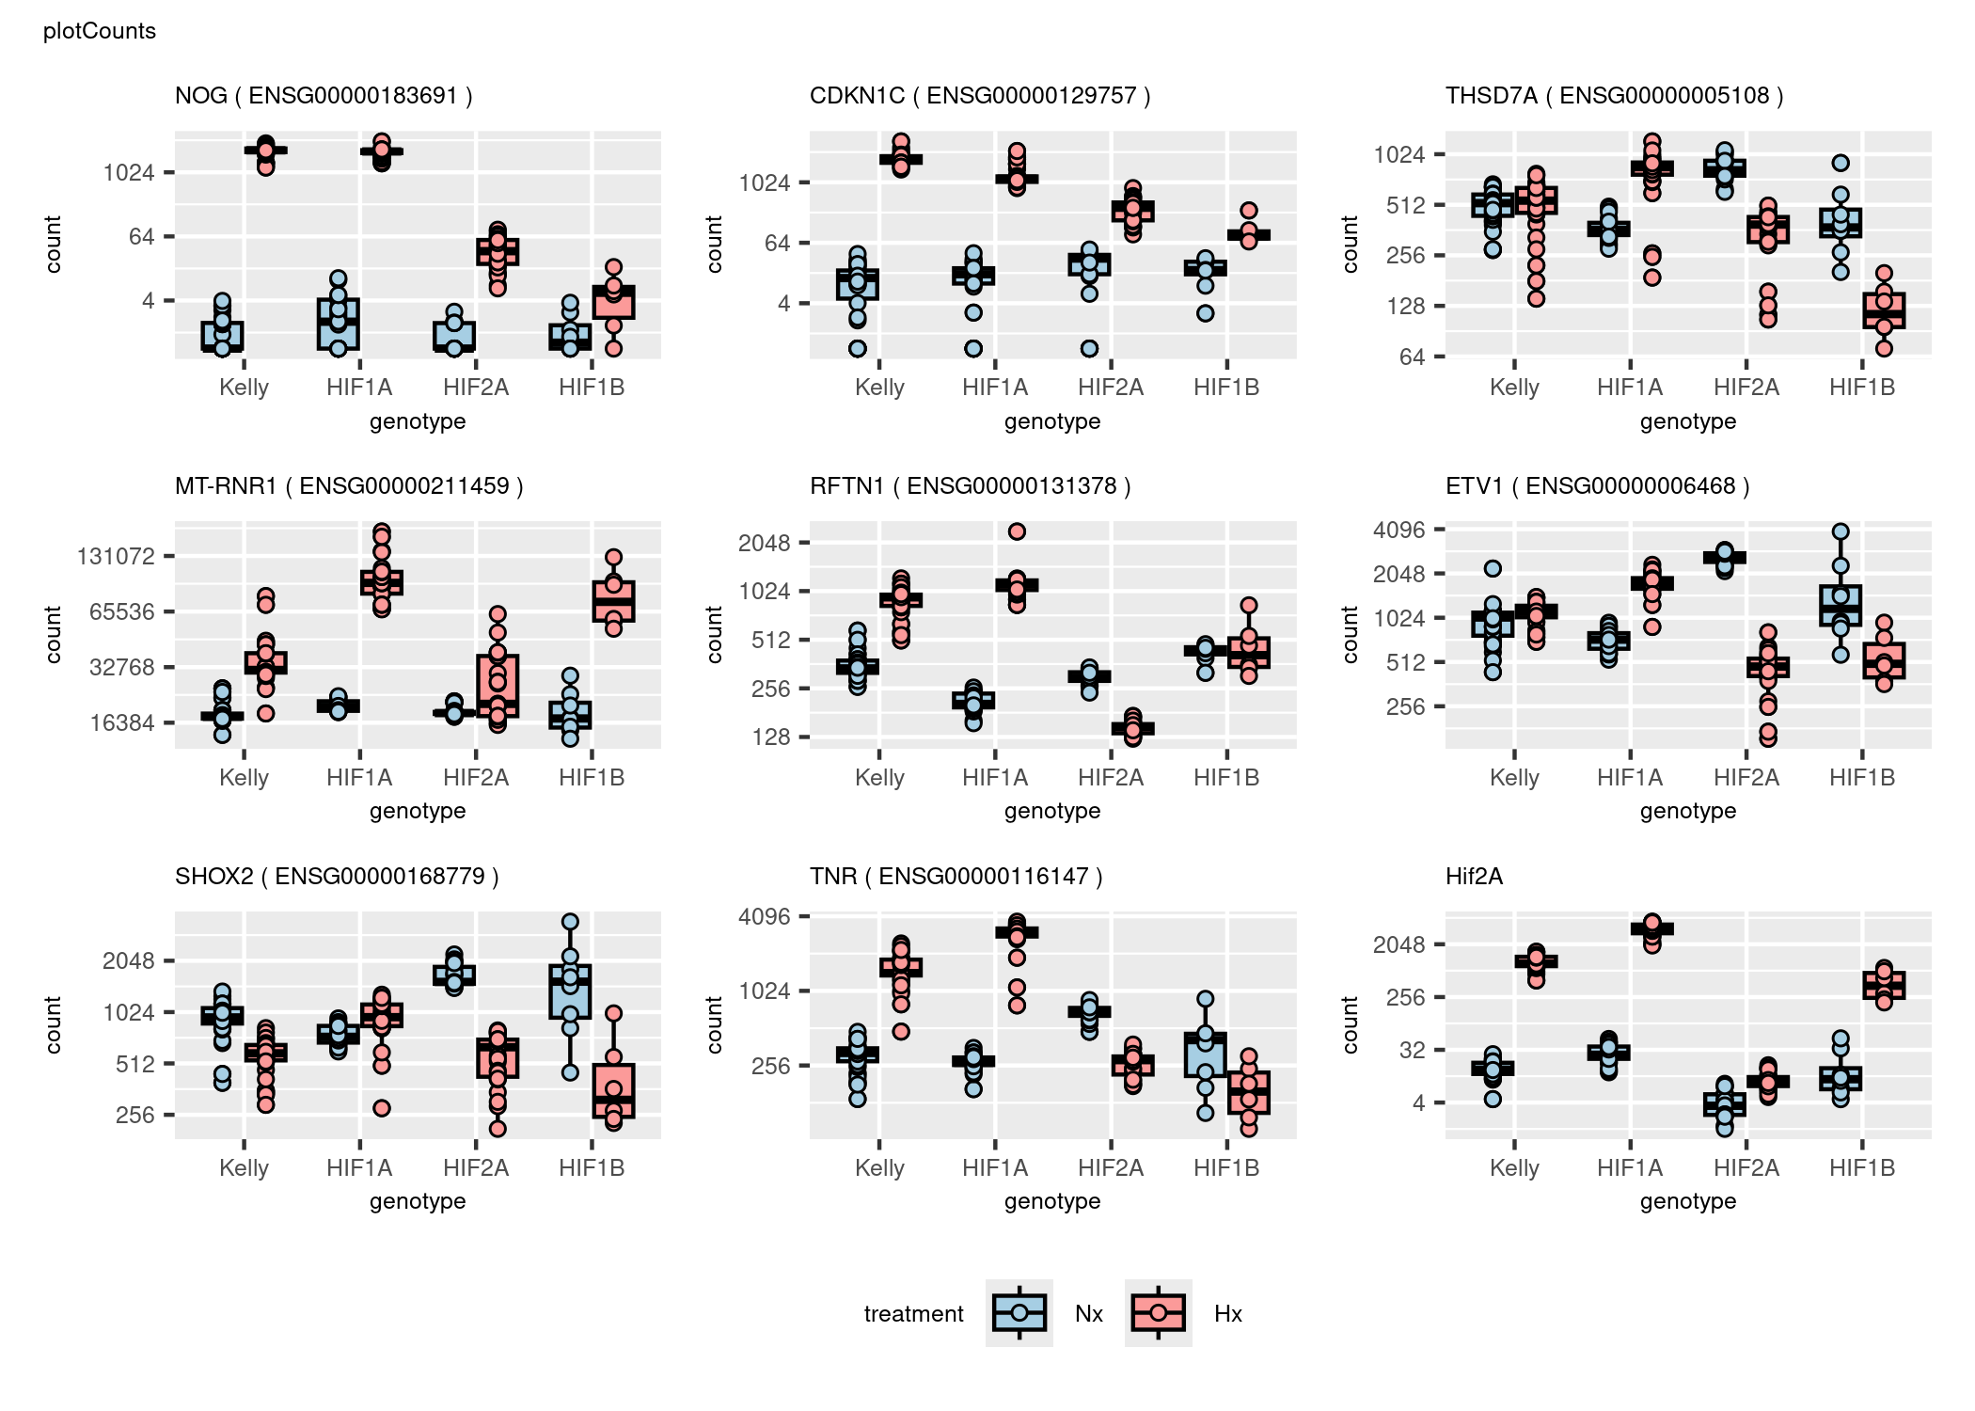

Slide 15
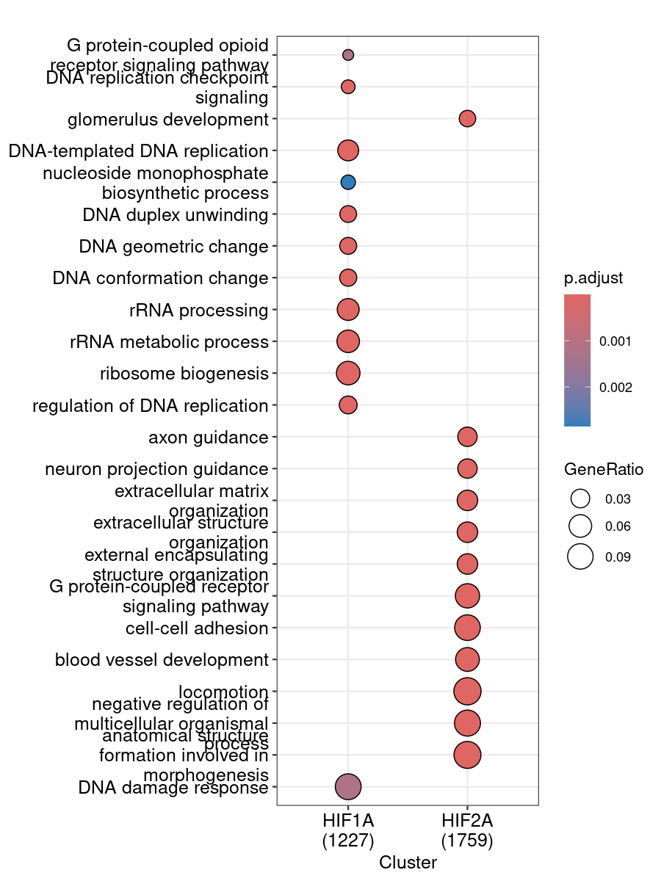
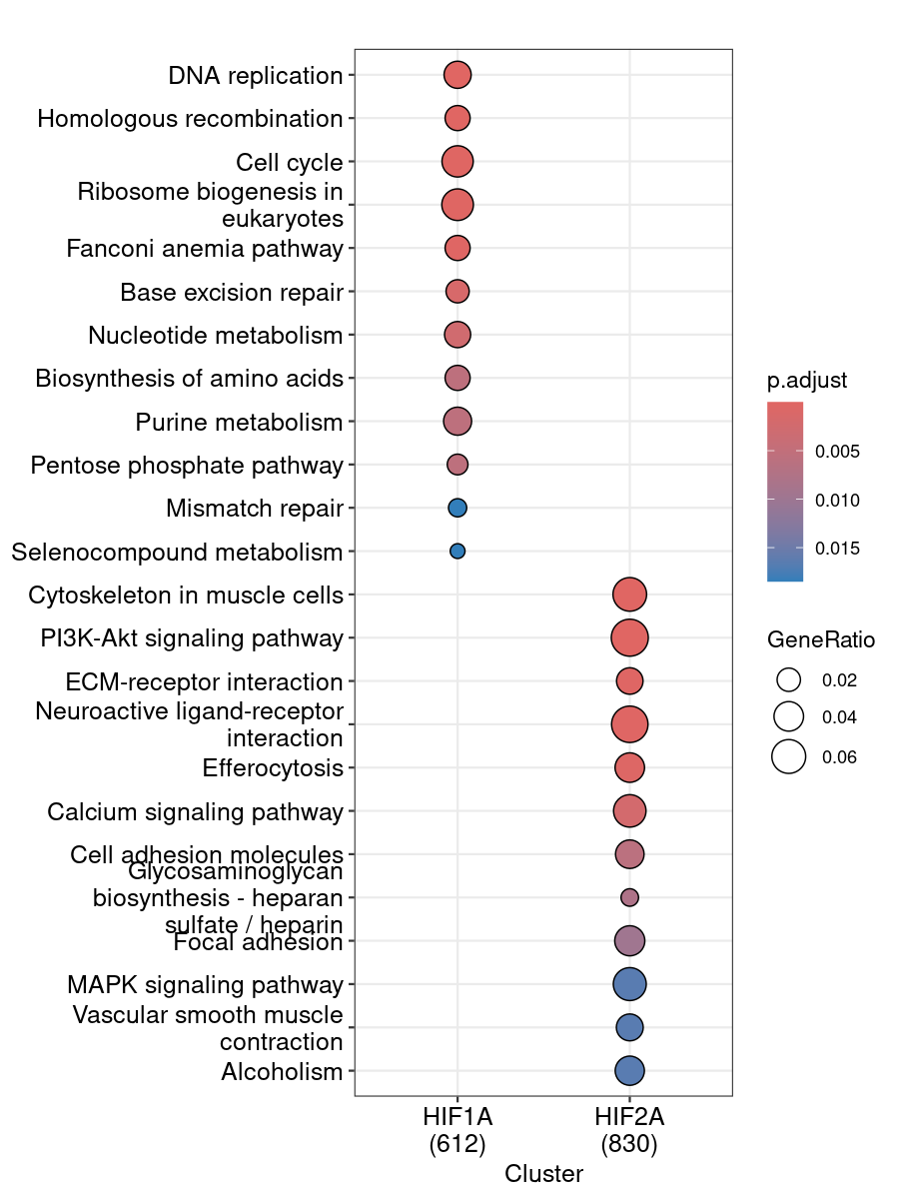
Fig. 4
GO-terms
KEGG

Slide 16
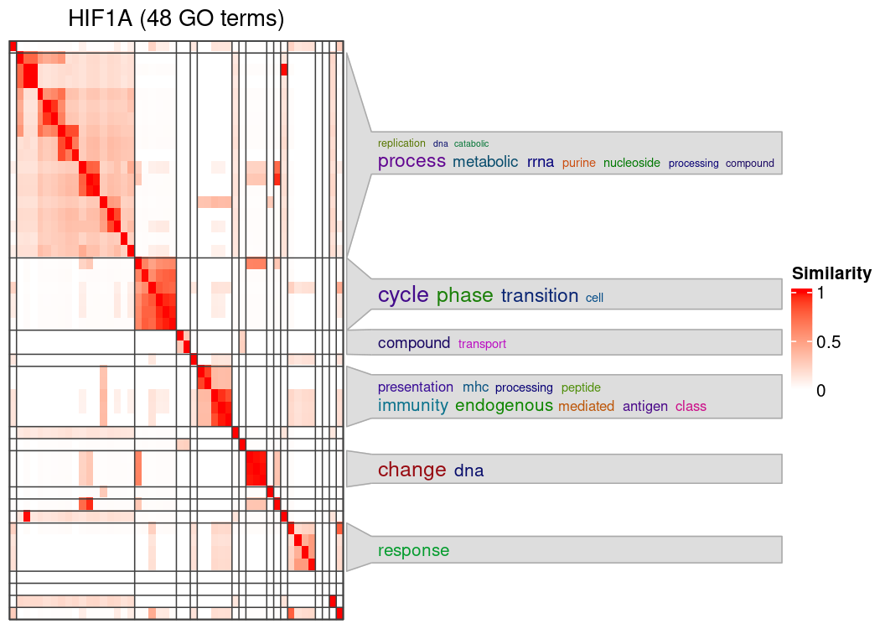
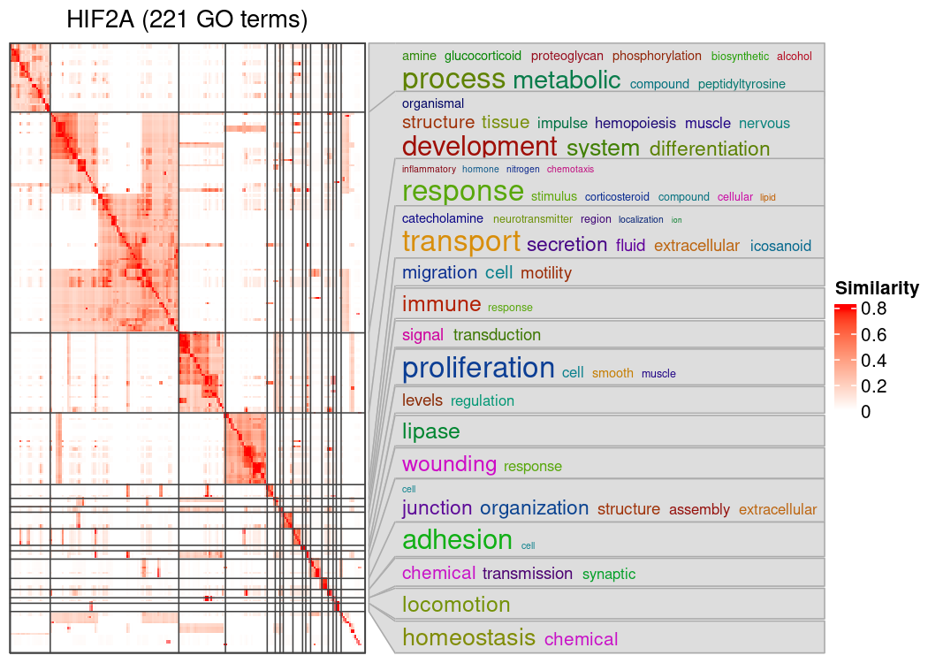
Notes:
Separate figures for HIF1A and HIF2a!

Slide 17
Figure 4. GO-terms analyis.
A) HIF-1a and HIF-2a responsive genes were screend for enriched GO-terms.
Interpretation:
Distinct gene programms for HIF1a and HIF2a.
HIF1a regulates cell state and cell cycle genes
HIF2a regulates extracellular functions

Slide 18
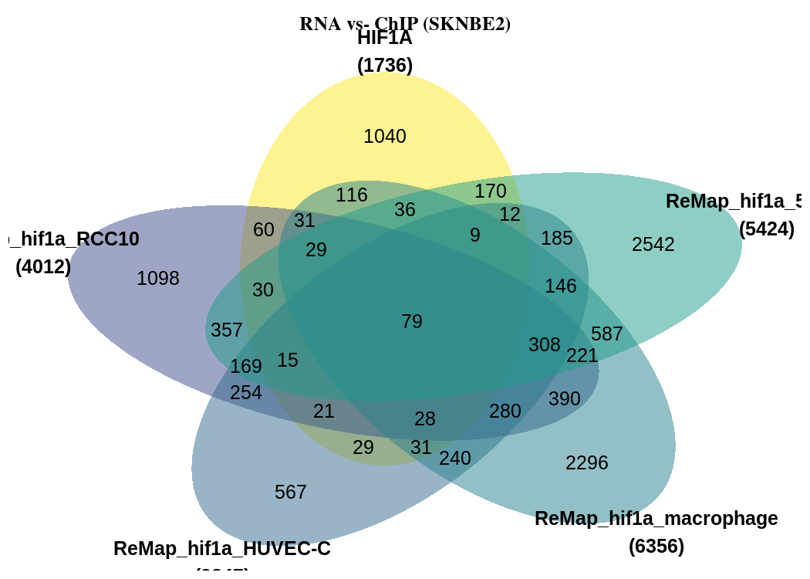
Figure 5: Compare RNA-Seq with ChIP-Seq results

Slide 19
Figure 4. Compare gene list with ChIP-Seq data from online databases
A) ChIP-seq data was taken from ReMAP database and gene lists were compared with RNA-Seq results.
Interpretation:
Genes differ for each tissue.
Core set of conserved 79 HIF-1A genes

Slide 22
old figures

Slide 23
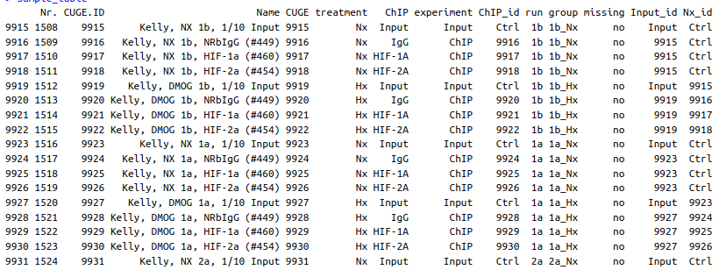
Extra: Kelly ChIP-Seq
1.) MACS peak calling
2.) Peaks - IgG
3.) Peaks -Nx

Slide 24
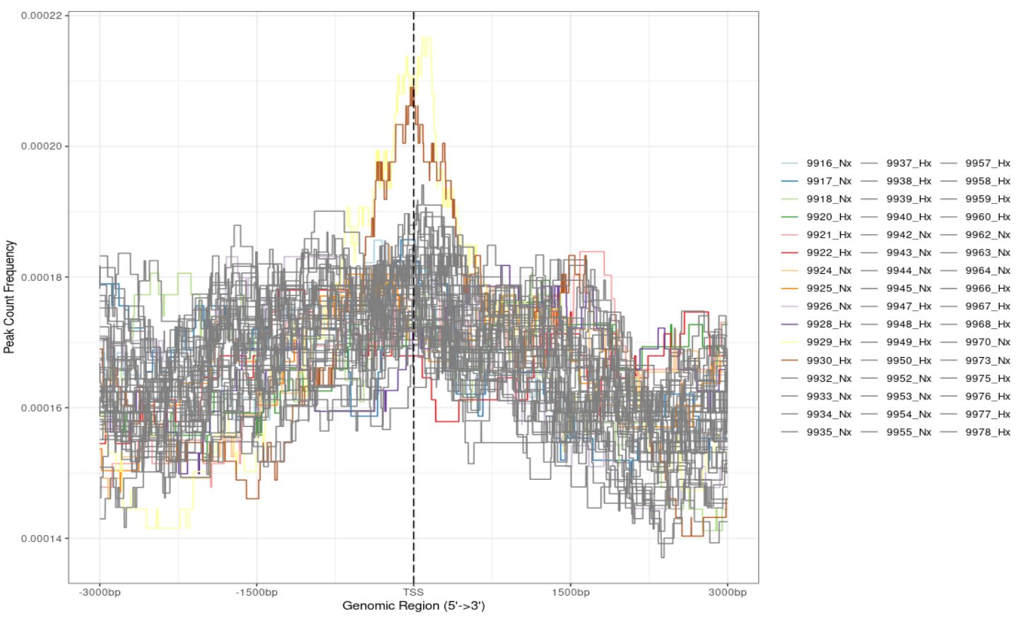

Slide 25
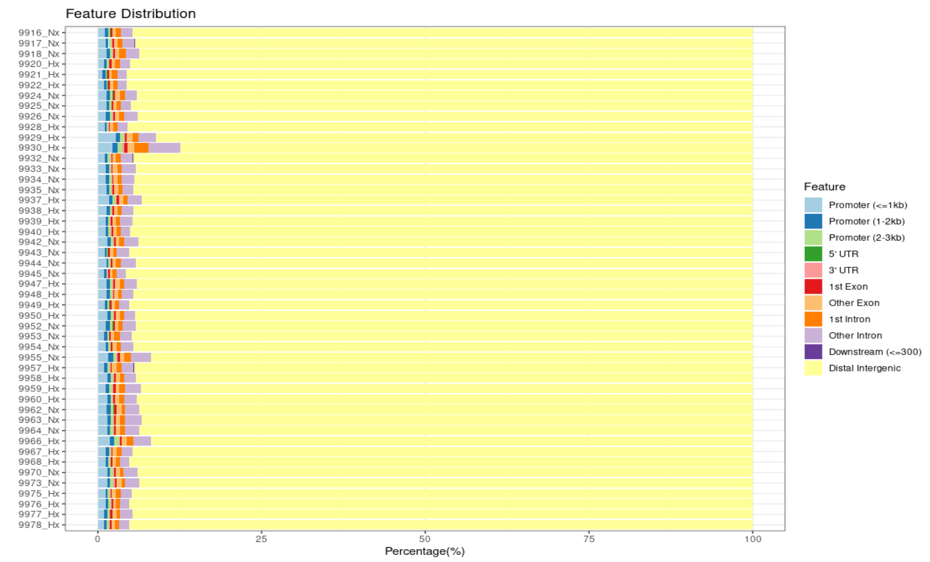

Slide 27
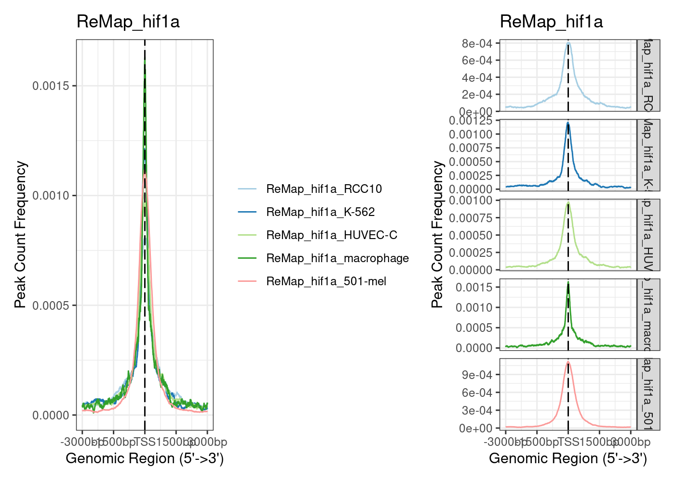
Other ChIP datasets: ReMAP

Slide 28
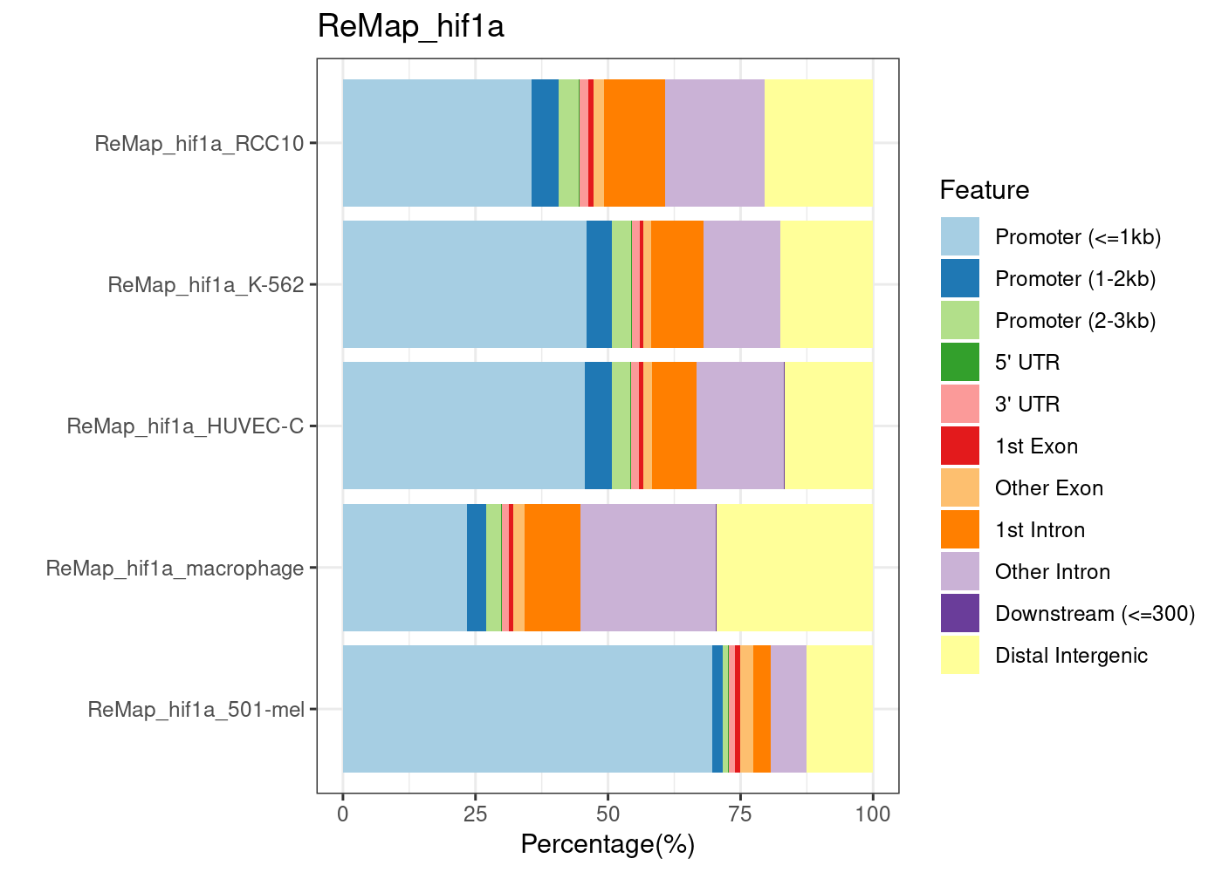
Other ChIP datasets: ReMAP

Slide 29
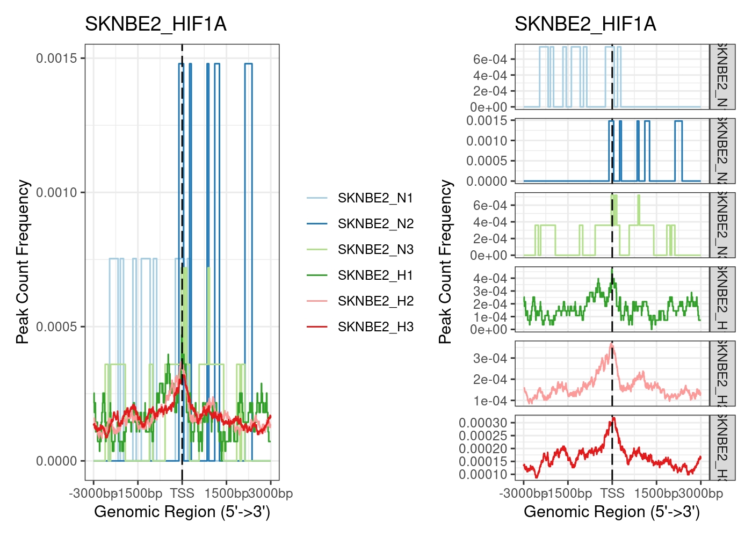
Other ChIP datasets: SKNBE2

Slide 30
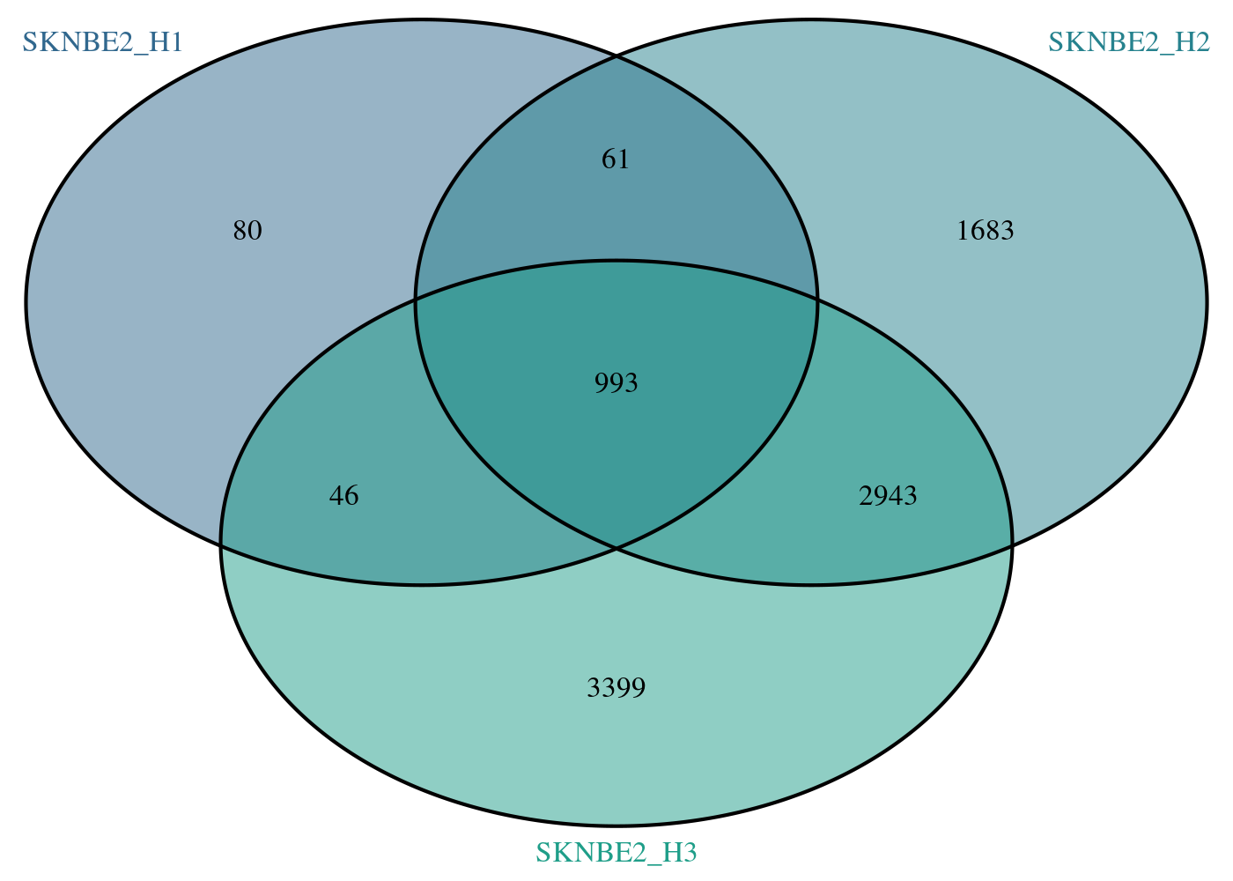
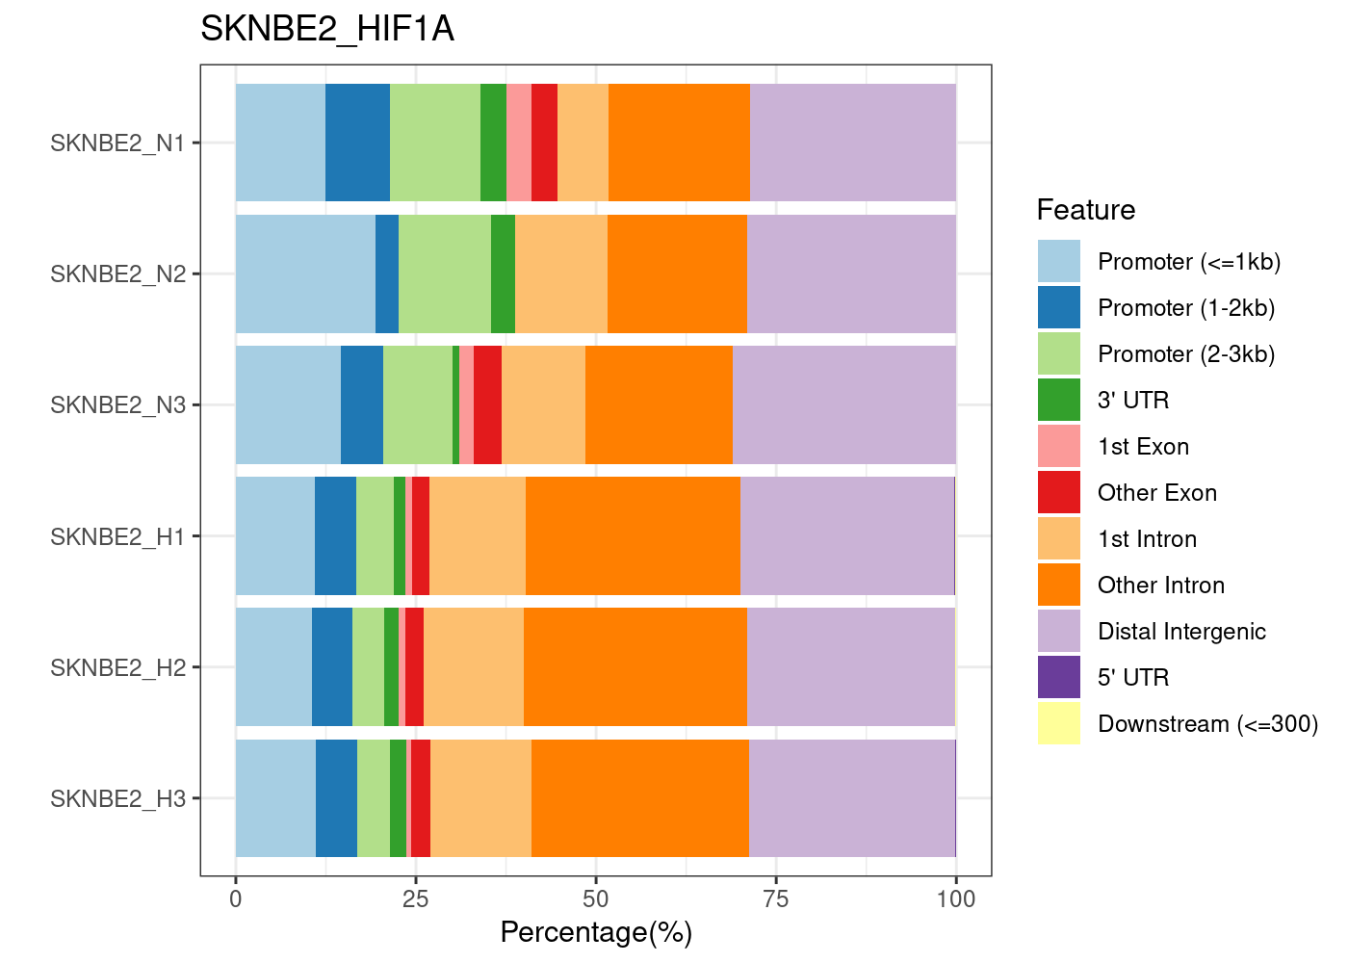
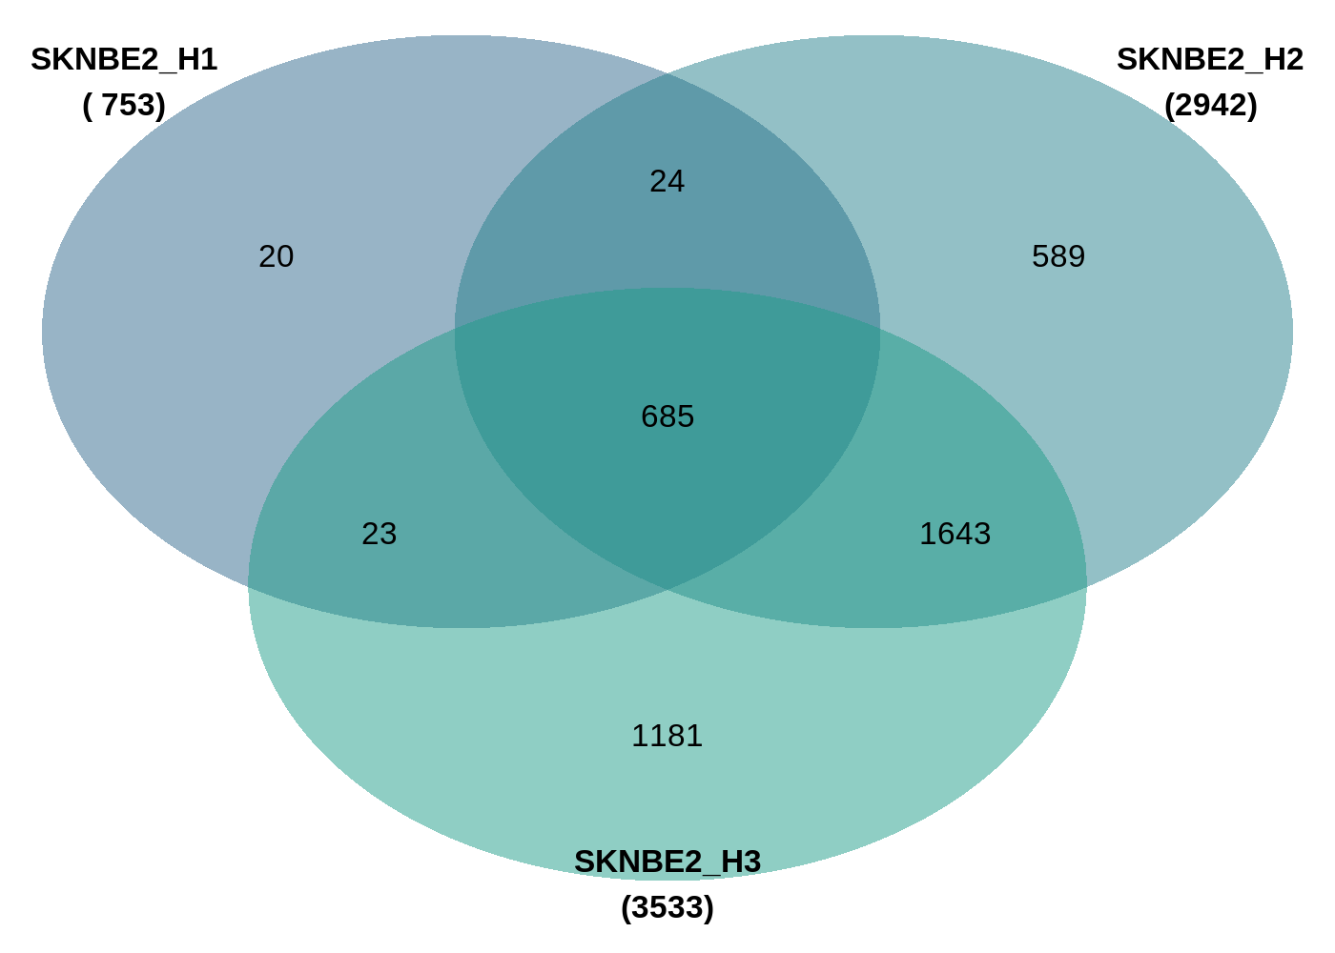
Other ChIP datasets: SKNBE2
Peaks
Genes

Slide 31
Other ChIP datasets: SKNBE2

Slide 32
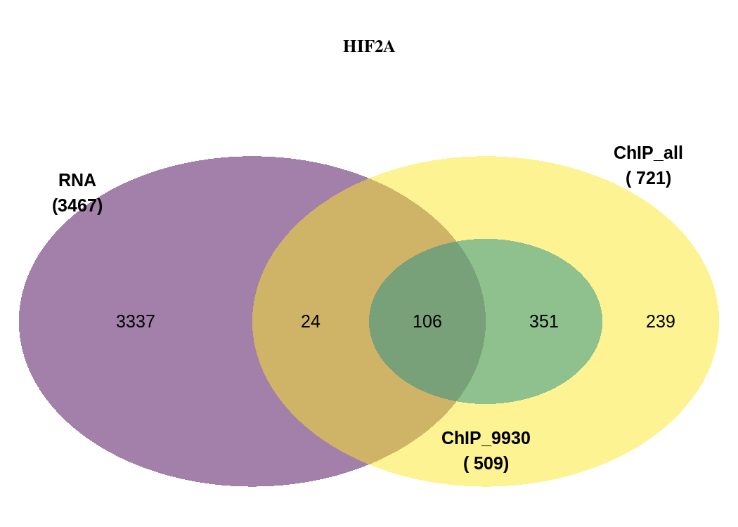

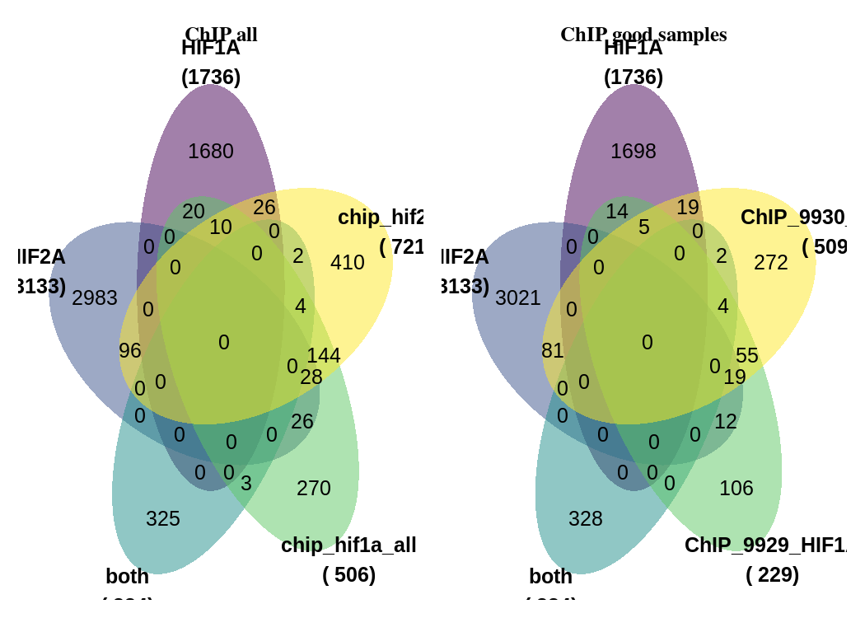
Figure 5: Compare RNA-Seq with own ChIP data

Slide 33
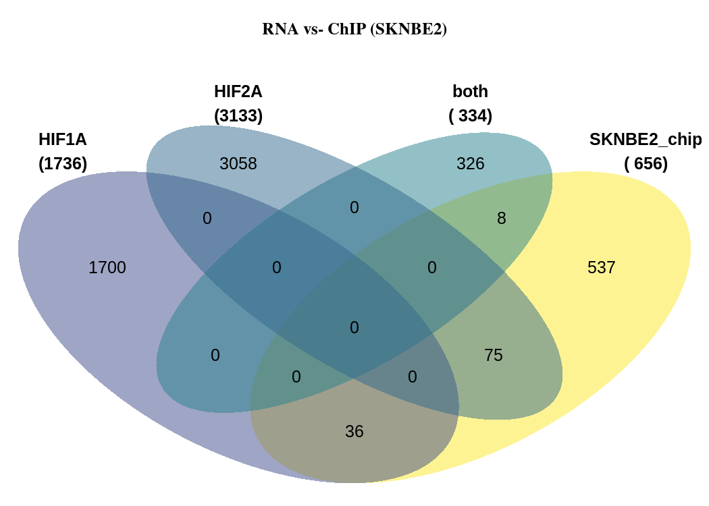
Figure 5: Compare RNA-Seq with SKNBE2

Slide 34
Figure 5: Compare RNA-Seq with ReMAP

